Slide 1
Parameter redundancy &
Local minima

Slide 2
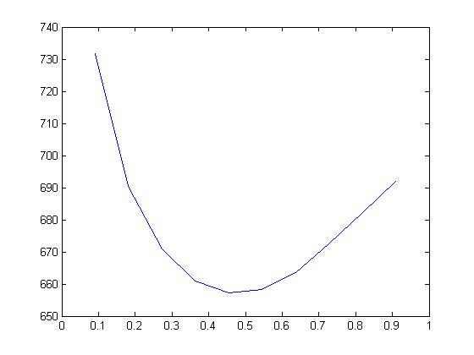
Profile Deviance for one parameter
deviance
MLE

Slide 3
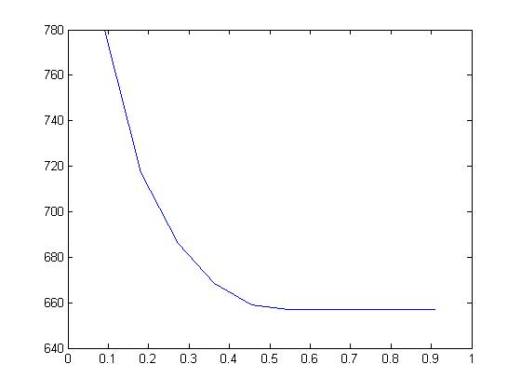
Problem 1: Identifiability of a parameter

Slide 4
Problem 2: Local minima
895
894
893
892
891
890
889
888
887
886
885
0
0.2
0.4
0.6
0.8
1
1.2
1.4
Notes:
We turn to a real dataset, just to prove that ’s not a problem which was built by and for crazy statisticans...
I ’d want to thanks JM Gaillard for providing with the data.
Here, the local minimum was detected thanks to the experience of JDL and Anne-Marie.
Female roe deer data over 2 states (with fawn/without fawn)
So: Profile deviance of a 2 state model applied to roe deer data as a function of the probability of survival. While the MLE is equal to 1 (boundary estimates, corresponding to the overall minimum of the deviance over the interval [0,1]), the deviance presents a local minimum equal to 886.454 in phi=0.2476

Slide 5
Problem 1: European dippers
Cormack-Jolly-Seber (CJS) model
(φ_{t},p_{t})
φ₆ | p₇
0.73 | 0.73
Deviance
= 656.95
    Deviance = -2Ln(L)
Notes:
When we fit the CJS model to the ED data set with M-SURGE, the last survival and last capture probabilities are estimated at 0.73,
and the deviance is ...

Slide 6
Problem 1: European dippers
Cormack-Jolly-Seber (CJS) model
(φ_{t},p_{t})
φ₆ | p₇
0.73 | 0.73
0.59 | 0.90
0.53 | 1.00
Deviance = 656.95
φ₆ has several Maximum Likelihood Estimates (MLEs)
φ₆ is not estimable
Notes:
p₆ has also changed each time and it can be verified that the product φ₅ p₆ has a unique value and is thus estimable.

Slide 7
Problem 1: European dippers
Cormack-Jolly-Seber (CJS) model
(φ_{t},p_{t})
φ₆ | p₇ | φ₆ p₇
0.73 | 0.73 | 0.53
0.59 | 0.90 | 0.53
0.53 | 1.00 | 0.53
Deviance = 656.95
the product φ₆p₇ is estimable
1 of the 2 parameters φ₆ or p₇ is redundant
Notes:
With φ₅ and p₆ we have one too many parameter!

Slide 8
Estimability
For all practical purposes,
estimable ⇔ non-redundant
Note: A redundant parameter is never estimable (no unique optimal value)
Notes:
Could it happen that a parameter that has several MLE is not redundant?
Not in multistate CR

Slide 9
Why bother about parameter redundancy?
Crucial for model selection because:
AIC = deviance + 2 x np
e.g. for the Dipper data set:
(φ_{t},p) np = 7 AIC = 674
(φ,p) np = 2 AIC = 671
(φ_{t},p_{t}) np = 11 AIC = 679
(np ≠ 12)
# estimable parameters

Slide 10
Why bother about parameter redundancy?
Crucial for interpretation (MLEs):
e.g. for the Dipper data set:
MLE of φ₆ p₇ = 0.53
E-SURGE and MARK give φ₆ = 0.728 and p₇ = 0.728
but φ₆ = 0.59 and p₇ = 0.9 might be the truth

Slide 11
Two different questions
for a parameter redundant model
QUESTION 1: how many parameters are estimable?
QUESTION 2 (advanced): which (functions of) parameters are estimable?

Slide 12
Studying Intrinsic Redundancy the formal method
(Catchpole, Morgan et al., 1997; 1998; 2001
Gimenez et al., 2003, 2004)
The only solution for solving Q2!
This method uses symbolic calculus software* to compute how many and which (function of) parameters are non-redundant
Unfortunately, often fails for multievent models (but see Rouan’s PhD thesis)
*MAPLE
Notes:
2) FORMAL: the symbolic calculation of the rank of a matrix of derivatives of probabilities with respect to parameters = the number of identifiable parameters is derived formally by means of symbolic algebra softwares like Maple.
la méthode formelle est destinée à étudier l ’identifiabilité du modèle indépendanmment des données, on parle d ’intrinsic identifiability. numeric is extrinsic...
I won ’t give more details because it remains a method difficult to apply except for the authors of the method. Indeed, you need…

Slide 13
Redundancy in practice numerical approach
The standard numerical approach based on second order derivatives not totally reliable
The approach adopted in E-SURGE combines the formal & numerical approaches (Rouan et al. 2009, Choquet & Cole 2012):
the rank of a matrix of first derivatives calculated numerically at 5 points around the MLEs
=
the model rank
=
the number of non-redundant parameters
Notes:
NUMERICAL: number of identifiable parameters = rank of a matrix, the matrix of the second order derivatives of the log-likelihood with respect to parameters: but its computation is not totally reliable. However this matrix is computed numerically, so that computing its rank is not easy.
In Mark, you ’ve noticed this number is often underestimated even though the option « second order » performs better than the « hessian » one.
...resulting in a wrong ordering of the models by AIC.

Slide 14
Redundancy in practice output of (φ_{t},p_{t}) with European Dippers
---------------------------------------------------------
11 singular values bigger than :4.7684e-007
May be 0 more parameters are non-estimable
---------------------------------------------------------
---------------------------------------------------------
1 quantities solutions of 1 partial derivatives equations, made of redundant parameters (indices below) are estimable
6 12
...
par #6 is last capture
par #12 is last survival
Notes:
NUMERICAL: number of identifiable parameters = rank of a matrix, the matrix of the second order derivatives of the log-likelihood with respect to parameters: but its computation is not totally reliable. However this matrix is computed numerically, so that computing its rank is not easy.
In Mark, you ’ve noticed this number is often underestimated even though the option « second order » performs better than the « hessian » one.
...resulting in a wrong ordering of the models by AIC.

Slide 15
limits of the numerical approach
1 – the threshold for nullity is empirical
2 – boundary parameters are a difficulty
⇒ first 4 points are shifted away from the boundary, last point is the MLE itself.
one answer
Notes:
This is the method used by MARK…
PB : which parameters ARE estimable?

Slide 16
the profile-deviance approach
(Lebreton and Pradel, 2002; Gimenez et al. 2005)
A visual method for redundancy based on:
Redundancy results in a flat ridge in the deviance
    plot of the profile deviance*
* the deviance as a function of the parameter under investigation and simultaneously minimized over the other parameters
Notes:
We advocate the use of the profile deviance = deviance as a function of a focal parameter and simultaneously minimized with respect to the other parameters.

Slide 17
Profile Deviance for the CJS model: Dipper data set
deviance
MLE
φ₃
φ₃ is estimable

Slide 18
Profile Deviance for the CJS model: Dipper data set
φ₆ | Dev
0.73 | 656.95
0.59 | 656.95
0.53 | 656.95
0.35 | 670.27
deviance
+
+
+
+
φ₆
φ₆ is not estimable

Slide 19
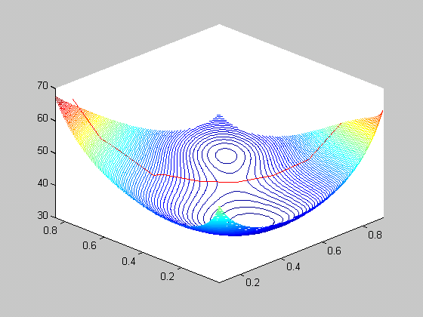
Problem 2: Local minima
Profile Deviance
Simulated data (J. Dupuis)
2 sites, 7 occasions
Survival = 1, P, Ψ_{f.to}
ψ(21)
ψ(12)
Sensitivity to initial values
Notes:
Simulated dataset (J. Dupuis) fitted with, For the sake of clarity, I will consider a simple multistate model, and pedagogic so unrealistic situation since only 3 param have to be estimated.
Modèle où F, fidélité est contrainte à 1, whatever the number of states and occasions, les transitions ne dépendent que de la strate et la capture est constante pour state et occasion.
2 states and 7 capture occasions
Deviance as a function of psi12 et psi21, and simultaneously minimized with respect to p
Let ’s have a look at the results:
deviance
Déviance(local)=80.210
Déviance(global)=79.447
Estimates
Global
psi12=0.60;psi21=0.84
Local
psi12=0.25;psi21=0.34
Ligne rouge, frontière délimitée par les différentes valeurs initiales essayées (AM Reboulet).
On the right of this line, you will tend to the global while on the left, to the local.
Great sensitivity to the choice of initial values!
Note: Mark converge to the global maximum

Slide 20
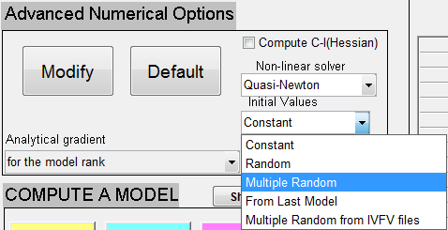
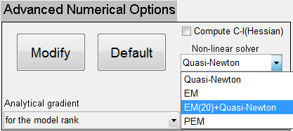
Problem 2: Local minima
Solutions in E-SURGE are:
a good guess (IVFV)!
a random initial starting point,
several such points,
the MLE of a previously-run related model
another non-linear solver like
EM(20)+Quasi-Newton
Notes:
Simulated dataset (J. Dupuis) fitted with, For the sake of clarity, I will consider a simple multistate model, and pedagogic so unrealistic situation since only 3 param have to be estimated.
Modèle où F, fidélité est contrainte à 1, whatever the number of states and occasions, les transitions ne dépendent que de la strate et la capture est constante pour state et occasion.
2 states and 7 capture occasions
Deviance as a function of psi12 et psi21, and simultaneously minimized with respect to p
Let ’s have a look at the results:
deviance
Déviance(local)=80.210
Déviance(global)=79.447
Estimates
Global
psi12=0.60;psi21=0.84
Local
psi12=0.25;psi21=0.34
Ligne rouge, frontière délimitée par les différentes valeurs initiales essayées (AM Reboulet).
On the right of this line, you will tend to the global while on the left, to the local.
Great sensitivity to the choice of initial values!
Note: Mark converge to the global maximum

Slide 21
Recommendations
Redundancy:
Parameters listed in the temporary window of E-SURGE should be considered with caution.
If present in the 4 first lists, they are probably redundant and their estimation should not be trusted.
If it is critical to know exactly whether they are estimable (when dealing with one of the best model usually).
Notes:
Now the model is being fit. The rank of the model conditional on the data is estimated
by computing the rank of a matrix composed of the gradient of each history probability
collapsed together and estimated near the mles. Getting the correct value for the rank of
the model is critical for model selection and we implement a very precise algorithm using
a numerical version of the Catchpole Morgam Freeman approach [4](see also section 7.2).
e-surge proposes a model rank by default that you can modify. Here, the rank is estimated
correctly at 69 (see Figure 19).
When the optimization of a new model stops, the program examines whether it has not
stopped at a saddle point in which case a warning is issued(see [7]). Then, it looks for
redundant parameters. This is done by analyzing the singular values of a derivative matrix
(see [4] for details and section 7.2) at 4 points in the neighborhood of the mle and at
the mle itself. The estimated model rank at each of the five points is shown in the dos
window (see Figure 20) while one list of potentially redundant parameters corresponding
are listed for each point in a temporary window (see Figure 21). The user is then prompted
to validate the estimated rank and to name the model. This done, the new model takes its
place in the list of previous models maintained in the Output area of the main window (see
Figure 20).

Slide 22
Recommendations
Local minima:
This is a plague of multievent models.
One of the best option is to start from where a simpler nested model converged.
Second choice is multiple random,
unless you know more or less the answer! (IVFV)
Best with the EM(20)+Quasi-Newton non-linear solver option

Slide 23
Catchpole, E.A. and B.J.T. Morgan (1997), “Detecting parameter redundancy”, Biometrika, 84(1), p 187-196.
Catchpole, E.A. , B.J.T. Morgan and S.N. Freeman (1998), “Estimation in parameter-redundant models”, Biometrika, 85(2), p 462-468.
Catchpole, E.A. and B.J.T. Morgan (2001), “Deficiency of parameter-redundant models”, Biometrika, 88(2), p 593-598.
Choquet, R. and D.J. Cole. (2012) A Hybrid Symbolic-Numerical Method for Determining Model Structure . Mathematical Biosciences. 236, pp. 117-125 DOI: 10.1016/j.mbs.2012.02.002
Gimenez O., Choquet R. and J.-D. Lebreton (2003). Parameter redundancy in multistate capture-recapture models. Biometrical Journal 45: 704-722.
Gimenez O., Viallefont A., Choquet R., Catchpole E.A. and B.J.T. Morgan (2004). Methods for investigating parameter redundancy. Animal Biodiversity and Conservation 27: 561-572.
Lebreton, J.-D. & Pradel, R. (2002). "Multistate recapture models : modelling incomplete individual histories." J. Appl. Stat. 29: 353-369.
L. Rouan. Apports des chaines de Markov cachées a l'analyse de donnés de capture-recapture. PhD thesis, 2007.
Rouan L., R. Choquet, R. Pradel (2009). A General Framework for Modeling Memory in Capture-Recapture Data. JABES, 14(3) 338-355.

